Slide 1
Finance Tracker Web Application
Final Project, IT Talents Season 13

Slide 2
Who are we?
Dimitar Karazapryanov
Panayot Panayotov
Medical student.
Might have developed OCD over the past few weeks.
Former bartender.
Turns into a proficient debugger after a glass of wine.

Slide 3
Functionalities
Register, Verification with email, Login, Reset forgotten password, Logout
Edit profile, Upload profile image
Create, edit, delete:
Money accounts
Transactions
Budgets
Recurrent transactions (Planned payments)
Close budgets (archive) and open them later
Use default categories and create custom ones
Receive PDF statement of transactions via email
Accurately convert account balance to a different currency
View entities filtered by various criteria and statistics
*Roles: User, Admin

Slide 4
Technologies and APIs
Java 15, Html5
Spring:
Framework
Boot + Tomcat
Security
Data: JPA + Hibernate;
JdbcTemplate
MVC: REST
WebClient
Lombok
ModelMapper
Java Mail Sender
Apache PDFBox
Apache Tika
Bean Validation API
Thymeleaf
Passay
ExchangeRate-API
Maven
IntelliJ; MySQL; Postman; Git

Slide 5
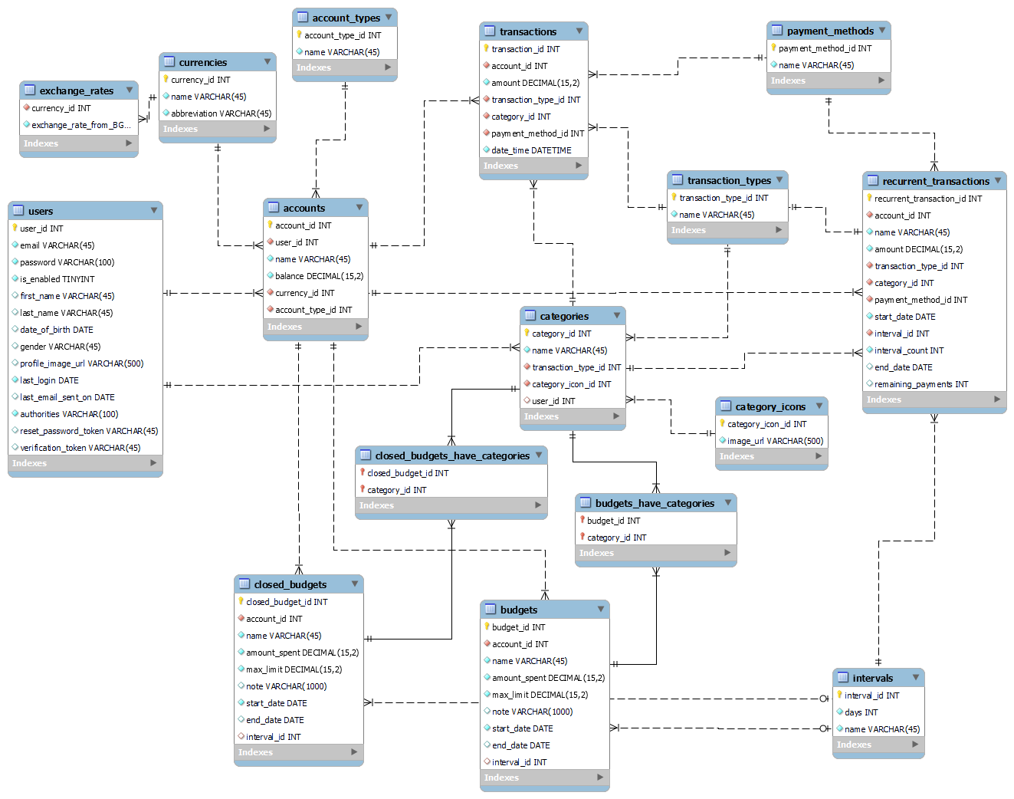
ER Diagram

Slide 6
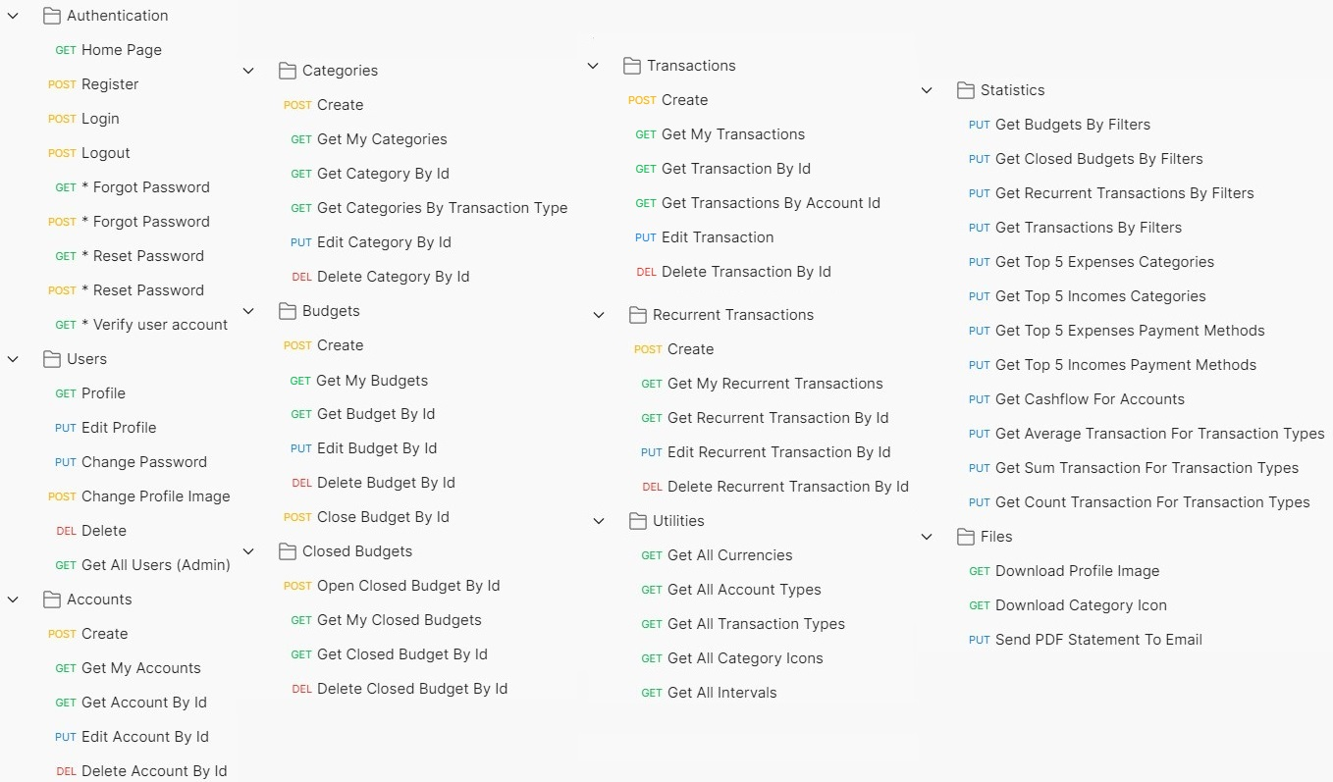
HTTP Endpoints

Slide 7
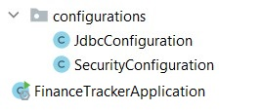
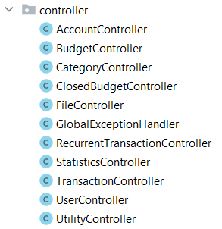
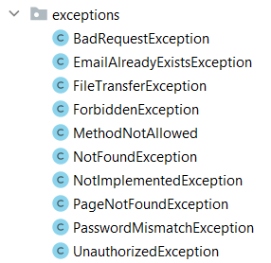
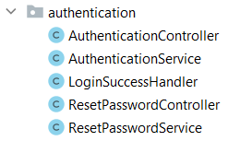

Class structure
Configurations
Controllers
Exceptions
Security-driven authentication
Custom validation

Slide 8
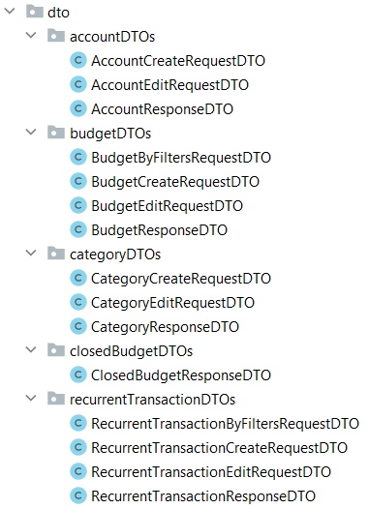
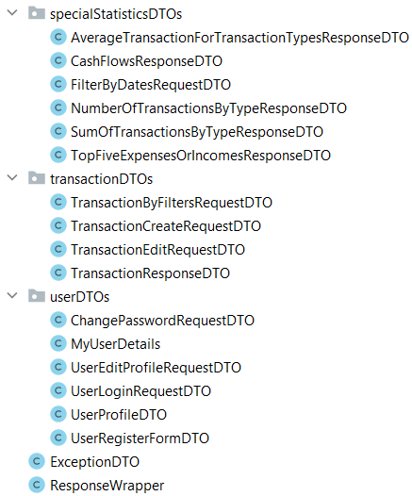
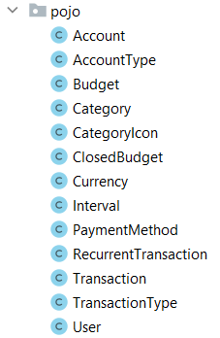
Class structure
DTOs
POJOs

Slide 9
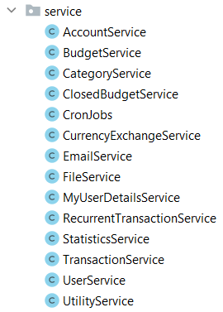
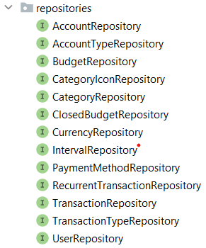
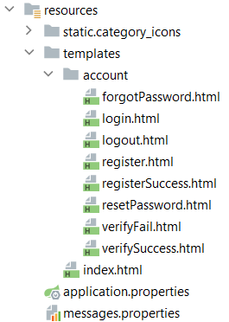
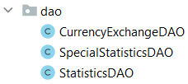
Class structure
Services
Repositories
HTMLs
DAOs

Slide 10
DEMONSTRATION (Disclaimer)

Slide 11
Thank you for your time!
Questions?

